Slide 1
Late Middle Ages
1300-1450

Slide 2
Prelude to Disaster
How Did Climate Change Effect the Middle Ages?
Climate Change:
Little Ice Age 1300-1450
Great Famine 1315-1322
Social Consequences
Abandonment of Villages and Declining population
Scapegoats
Governmental Responses
Notes:
Colder Wetter weather from 1300-1800- Traceable by natural and human sources
Harsh climate = less hardy crops survive
Storms caused torrential rain that ruined wheat and hay- people and animal food
Lack of food due to poor harvests led to Great Famine in Northern Europe
Increased prices of grain, livestock, and dairy led to less people affording food
Reduced diets led to susceptibility to disease, esp. in women and infants and lower output by workers which led to higher grain prices
People abandoned villages to search for work and food
Anger was focused on rich, speculators and Jews (moneylenders). Rumor Jews used lepers to kill Christians leading to abuse and death of lepers and Jews.
Connections: English sheep disease led to less wool, led to Flemish weavers not working, led to Flemish, Hanseatic, and Italian merchants suffering

Slide 3
Black Death
How did the Black Death affect European Society?
Pathology
Yersinia Pestis
Pneumonic Transmission
Effects on the Body
Spread of Disease
From China to Europe
Spread within Cities
Mortality Rates
Notes:
Increase in shipping carried vermin and rats allow diseases to spread
Yersinia Pestis bacteria carried by rats and fleas, fleas jump to humans
Person to person infection by coughing and sneezing
Effects lymph system- puss filled bubos
Blackening of skin, coughing blood and death followed
Originated in China then spread along trade routes. Rats and humans carried disease by ship, especially along the Black Sea
Mongol attackers flung infected bodies into cities they were conquering
October 1347 Genoese ships brought plague from Black Sea to Messina and spread it to Sicily and Italy and over the Alps to German nations
June 1348 two ships entered Bristol harbor and infected England and Scandinavia
Urban environment was ideal for spread with narrow streets and weakened populations

Slide 4
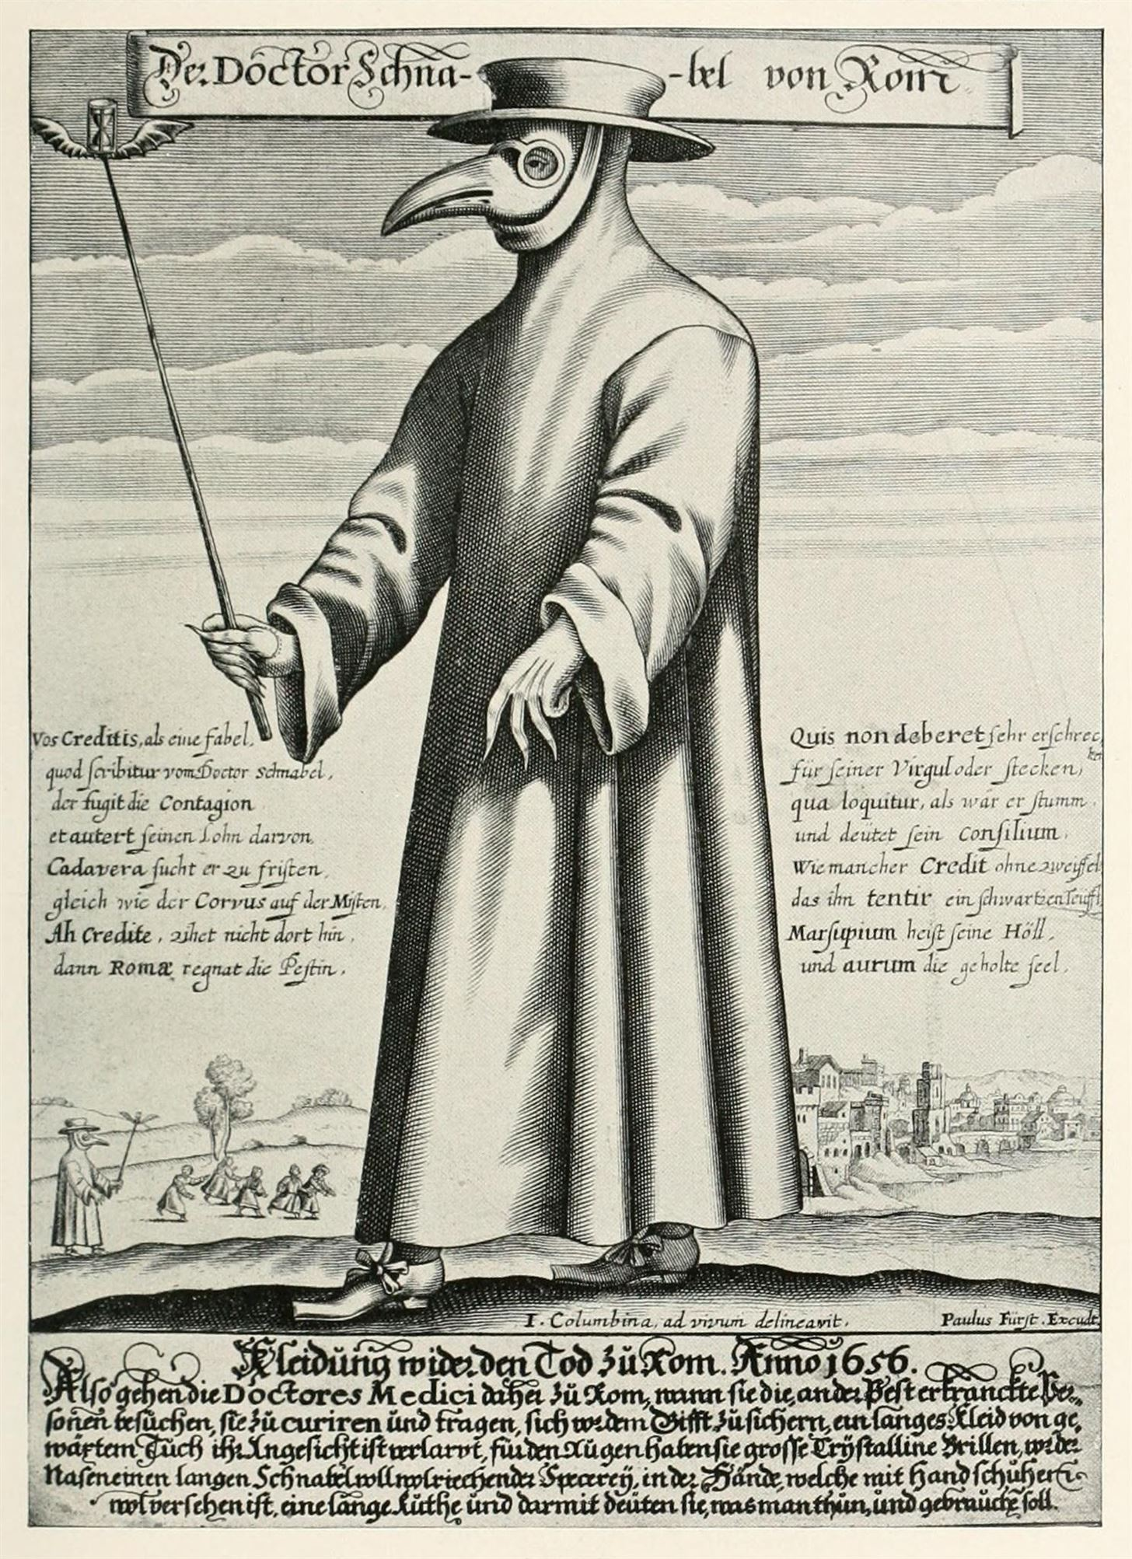
Black Death
Care of the Sick
Remedies
Care by the Clergy
Escape
Economic, Religious, and Cultural Effects
Agriculture
Inflation
Religious Responses
Dance of Death pg. 301 https://www.christianiconography.info/Edited%20in%202013/Croatia%202012/danceDeathKastav.html
New Universities
Notes:
1721 Last appearance in Europe. 1947 Waksman discovers cure: streptomycin
Blocking “poisoned air’ with incense or herbs, inducing vomiting, sweating, and blood letting. Making loud sounds like bells and cannons to rid the air of poison, use of bumpy or oozing plants for medicine, Muslims used cryptograms, wealthy fled to countryside (causing more spread), walling off cities and infected homes.
Clergy that did not flee cared for sick and suffered high mortality rate
Effect on economy differed. Drop in population allowed less fertile land to be abandoned leading to higher yields
Move to less labor-intensive agriculture like sheep raising and wine grape growing
Inflation caused by shortage of goods and rise in prices due to fall in production due to high mortality rate.
Wheat, meat and cheese rose. Lack of laborers allowed them to demand higher wages and granted them better mobility
Religion saw plague as god’s punishment for man’s evil and increased prayer and donations
Muslims urged people to live virtuously in face of death. Flagellants believed in doing penance by whipping themselves. Also killing jews
Dance of Death
New Universities formed due to the shortage of priests and learning w/ national or local constituencies
Medieval culture weakened leading to Schisms in Catholic Church

Slide 5
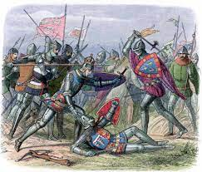
The Hundred Years War
What were the causes, course, and consequences of the Hundred Years War?
Causes
Disagreements over Royal land Rights
Succession Dispute
French Nobility Divided
Propaganda
Economic Reasons
English Successes
Initial English Successes
Later English Successes
Notes:
1337-1453 France and England
Cause 1.Duchy of Aquitaine-became part of England through marriage- Affirmed by Treaty of Paris 1259. French tried to absorb Aquitaine in 14th century
Cause 2: Disagreement over who would inherit the French throne after Charles IV and his childless son, Philip the Fair. His death ended the Capetian line. Charles IV’s sister Isabella married Edward II King of England. She and her lover Roger Mortimer conquered and captured her husband and his “man” Hugh le Dispenser. They killed Despenser and exiled Edward and installed Edward III as king. Caused French to proclaim, ‘no woman or her son may succeed to the monarchy’. The nobles passed the crown to Philip VI, a nephew of Philip the fair.
Edward III recognized his status as vassal to France, but objected when Philip VI confiscated the duchy. Edward argued that it was a cause for war and he should be the king.
Many French nobles supported Edward to remain or increase independence. Becomes a French civil war. Scotland backed French to resist assimilation.
Bot sides used clergy to manipulate public. French tried to use propaganda to create “Nationalism”
Flemish merchants depended upon English wool and supported Edward. Harmed by disruption of commerce w/ England.
Poor or idle knights gained cash in the war. Prisoners were granted pardons to enlist, Nobles wanted to get estates rewarded to them. Kings bribed soldiers with promise of spoils
War began with French sea raids, but French fleet was destroyed trying to land troops in England. After, war fought in France and “Low Countries”.
English longbowmen and cannons helped England to early victories. Tactic repeated 10 years later by Edward the Black Prince and later by Henry V. Henry married the French King’s daughter to eventually rule both but died leaving an infant son as heir

Slide 6
r
, "
1337
Philip VI of France confiscates Aquitaine; war
begins
1346
English longbowmen defeat French ^{knights}
at Crecy
English defeat French at Poitiers French recover some territory
English defeat the French at Agincourt
French victory at Orleans; Charles VII crowned king
1356
1370s-1380s
1415
1429
1431
Joan of Arc declared a heretic and burned at the stake
1440s
French reconquer Normandy and Aquitaine
1453
War ends
1456
^{Joan} cleared of charges of heresy and declared
a martyr

Slide 7
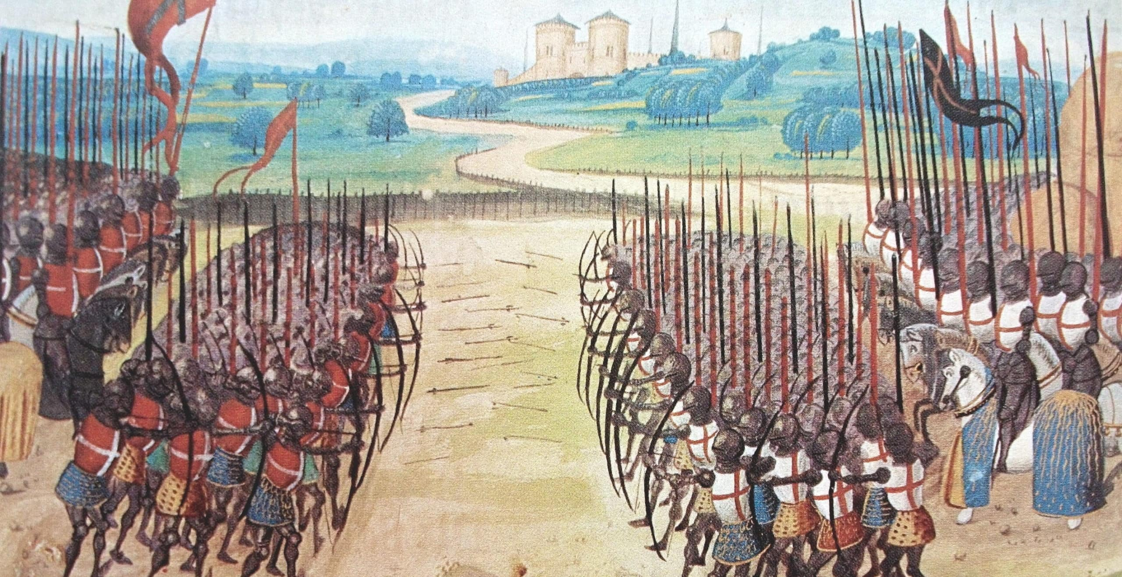
Hundred Years War
Joan of Arc and French Triumphs
Joan of Arc
Capture and Trial
Ultimate French Victory
Aftermath
Havoc in England and France
Technology and the Nation State
Representative Assemblies
Nationalism
Notes:
Vision and military leadership of Joan led to French victory. As a teen heard voices of saints and traveled through France to deliver them to the nobility.
Her victory at Orleans, dressed as a knight was a great blow to the English, and Charles VII was named king in 1429. in 1430 the English allies Burgundians capture Joan and the pro English Church court convict her of heresy (which se did not commit) and burn her at the stake.
French continued to win without her. Burgundians switched alliances and by 1453 on the town of Calais remained with the English.
Joan was re-tried by the pope in 1456, declaring her innocent of heresy and a martyr. In 1920 she was canonized.
The war affected France through the losses of soldiers, citizens, and farmland. This was amplified by the plague. Lack of trade led to France decrease participation in International commerce. Heavy taxes and defeat in battles led to dissatisfaction of citizens.
England saw battles in lower ports only, but suffered economically. The war cost 5 million pounds, a great financial loss. The English raised taxes on wool but succeeded to price English wool out of the market.
War disrupted the social order of both countries. Knights who served as justices of the peace, sheriffs, Coroners, and jurymen were abroad fighting.
Technology like the cannon revolutionized warfare. Walls could no longer protect cities. Only govts. Could afford them so it strengthened power of nation states.
War led to Parliament and other representative assemblies in Europe. British Parliament, German Diets, Spanish Cortes led to modern democracies.
Nationalism, especially in France flourishes

Slide 8
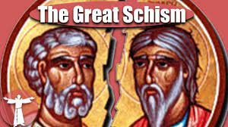
Challenges to the Church
Why did the Catholic Church face criticism?
Babylonian Captivity and the Great Schism
Babylonian Captivity (1309-1376)
Atmosphere of Luxury
The Great Schism (1378-1417)
Critiques, Divisions, and Councils
William of Occam (1289–1347)
Marsiglio of Padua (ca. 1275–1342)
Conciliarists
John Wyclif (ca. 1330–1384) and the Lollards
Jan Hus (ca. 1372–1415)
Resolution of the Schism
Notes:
Pope Boniface VIII fought with Phillip. When Clement V became Pope, Phillip pressured him to move to Avignon. Called the Babylonian Captivity from 1309-1376 Popes resided in Avignon.
Damaged papacy, cut off from Rome, its historic roots and source of power. Avignon popes became concerned with bureaucracy and finance, not spiritual matters. Lived lavishly, as did Bishops and their courts. Caused critics to emerge.
In 1377 Pope Gregory XI brought papacy back to Rome but died soon after. Pressured by Roman citizens to elect an Italian pope, Urban VI was elected.
Urban VI attacked church in tactless manner. Cardinals slipped away and declared Urban’s election invalid due to pressure from Roman mob, and excommunicated Urban, and elected Clement VII ant Avignon. There were two popes from 1378. Created the Great Schism, with Europe aligning with each Pope.
William of Occam (1289–1347) criticized the papacy and argued for separation between church and state. Marsiglio of Padua (ca. 1275–1342) wrote Defensor Pacis, claimed the church should be subordinate to the state and the church should be led by councils of clergy, theologians and lay people, no just the pope. Cociliarists were those who followed this belief. John Wyclif (ca. 1330–1384) went further than the conciliarists. Followers called Lollards. Called for the divesture of Church in property, called for the Scripture to be the standard of belief, eliminating power of Pope, which is not in scripture. Also encouraged people to read scripture for themselves, and translated the bible into English. Lollards were persecuted in 15th century and many continued to meet in secret and read religious text in English. University students at Oxford brought to ideas of Wyclif to Prague, capital of Bohemia. Jan Hus built on these ideas by denying papal authority, and calling for bible translation in Czech language, and denounced indulgences. Linked opposition to church wealth and power with the idea of Czech nationalism.
Schism remained a threat to church so council of Pisa deposed both popes and named selected another. Avignon and Roman Popes refused to step down, so there were 3 popes in 1409. Another Council in Constance 1414-1418 had 3 objectives, end heresy, resolve schism, and reform the Church. Hus was arrested and burned as a heretic in 1415. It deposed the Roman and the “Pisa” Pope and named Martin V as pope. He immediately dissolved the Council and no reform was done.

Slide 9
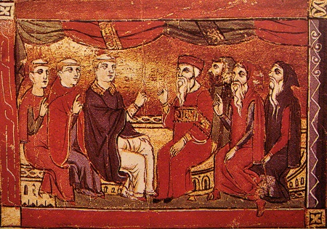
Challenges to the Church
Lay Piety
Lay Piety
Confraternities
Brethren and Sisters of Common Life
Mystical Experiences
Notes:
After the Schism, spiritual mystique of clergy was weakened. Led to laypeople to develop their own forms of piety separate from authority of priests and bishops.
Confraternities of lay men and women became organized and began ritualistic practices especially in cities and often without priests
Brethren and Sisters of Common Life began living gospel (feed the hungry, cloth the naked) in Holland at the end of the 14th Century. Put into word in The Imitation of Christ by Dutch monk Thomas a Kempis. They founded homes in the 15th century in Netherlands, Central Germany, and the Rhineland.
Bridget of Sweden noblewoman who traveled to Rome. She saw visions of VM and told people about them and give advice based upon them. Mystics were not heretics unless they challenged the authority of the pope

Slide 10
Trial of Jan Hus by Ulrich of Richental
Notes:
Wood carved printing

Slide 11
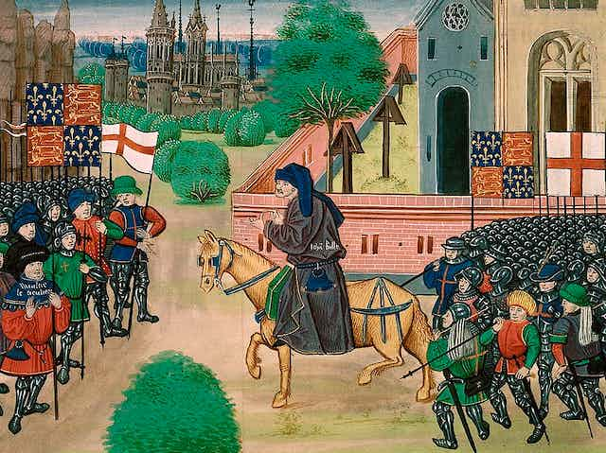
Social Unrest in a Changing Society
Peasant Revolts
Flanders (1320s)
Jacquerie (1385)
English Peasant Revolt (1381)
Urban Conflicts
Roots of Revolt
Honor Uprisings
Decline of Women’s Workforce
Notes:
Peasants produced food for nobles and clergy, but were overtaxed and exploited, leading to revolts in 14th and 15th century
Flanders revolt in 1320’s Peasants forced to pay tax to French and Monasteries pressed them for tithes. Caused revolt burning and pillaging castles, and aristocratic country homes. Crushed by French Army leading to confiscation of peasant property, and savage repression
Jacquerie revolt was a massive peasant uprising in opposition to French taxation after the 100 years war. Named after a mythical laborer, Jacques Bonhomme (goodfellow). Rebels caused massive destruction, killing nobles and burning castles. Pushed down by union of upper classes, which sent rebellion underground.
English Peasant revolt came from opposition to war tax, that was collected with force by sheriffs in 1381.Artisans, urban and rural poor attacked nobles. Archbishop of Canterbury among those killed. Richard II tricked revolutionaries with false promises and crushed the uprising. Nobles attempt to return to serfdom unsuccessful.
Revolts from changing conditions of work. New systems of larger scale production allowed capitalist investors to separate steps in the process, eventually allowing shop masters to run the show. Guild membership was limited and no chance for journeymen to rise to master, causing resentment toward masters and eventually revolt. Revolt also came from requiring employees to do work regarded as beneath them. Called honor uprisings. Guilds also worked to keep membership all male and passed regulations outlawing women. Often overlooked when the need for workers arose and the women could be paid less than men.

Slide 12
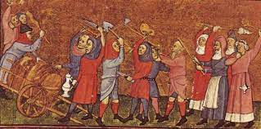
Social Unrest in a Changing Society
Sex in the City
Late Age of First Marriage
Prostitution
Rape
Homosexuality
Fur Collar Crimes
Noble Bandits
Robin Hood
Notes:
Belief that couples should be economically independent before marriage, led to later marriages. Women entered marriage as adults an had developed skills to run a household, not dependent on husband or mother-in-law.
Prohibition from marriage for university students, journeymen and apprentices left cities full of unmarried young men, who were the core of riots and unrest.
Led to the market for prostitution where brothel districts were established in cities. Women were sold into prostitution by parents or others as payment for debt. Poor women sold sex illegally outside city brothels. By the late 15th century prostitution was limited and more regulated.
Unmarried women servants were subjected to rape or sexual coercion. Rape laws required a woman to show she fought off her attacker and brought the charges within a short period of time. More about reputation and honor than punishment.
Same sex relations were permitted in middle ages but became scrutinized by late 12th century. Defined as crimes against nature. In most of Europe, same sex relations or Sodomy became a capital offense with execution by fire. Florence, Venice and Lucca had special agencies to investigate sodomy. Not a marginal practice in Europe, despite low numbers of investigations and executions. Same sex relations grew out of all male environments and led to homoerotic behavior being
Fur collar crime was medieval version of white-collar crime. Higher social class individuals prey on the less well off.
Nobles were idle during periods of truces and peace after 100 years war and had financial responsibilities beyond their fixed incomes. Many resorted to crime for income.
Violence and fraud. Knights groups demanded protection money or burned homes and fields. Ransomed wealthy travelers. Pushed peasants to pay higher taxes and fees. Bribed or intimidated witnesses against them. Robin Hood stories were folk legends of a group that robbed from the fur collar criminals, symbolizing the deep resentment of Aristocratic corruption and abuse, the struggle against tyranny and oppression.

Slide 13
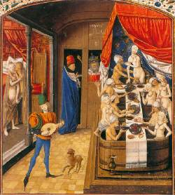
Social Unrest in a Changing Society
Ethnic Tensions and Restrictions
Ethnic Diversity and Colonization
Legal Dualism
Blood Descent
Literacy and Vernacular Literature
Dante’s Divine Comedy
Chaucer’s Canterbury Tales
Spread of Lay Literacy
Notes:
Migration within Europe in 12th and 13th centuries to search for work and food.
Towns recruited from the countryside, Far frontiers were filled with far immigrants, leading to colonization and causing people of different ethnicities living side by side.
Legal dualism existed where natives were subject to native law, but newcomers subject to the law from where they came.
Ireland was the exception with great discrimination of the Irish by English. The English distinguished between free and unfree, and Irish were unfree due to their birth. Irish were denied access to courts, English defendants did not have to respond to Irish plaintiffs in property disputes, Irish could not make wills, murder of Irish was not a felony.
Pluralism and dualism was replaced with a movement toward legal homogeneity with emphasis on blood descent. Dominant ethnic group kept others from potions of church leadership and laws against interracial marriages were instituted. Some churches promoted ethnic discrimination.
Statute of Kilkenny (1366) was a law discriminating against Irish blood. Forbid marriage between Irish and English, required use of English language, denying Irish access to ecclesiastical offices.
Blood was used in ethnic and religious discrimination and separation. Spain was obsessed with people having no Jewish of Muslim blood. Similarly nobles used blood to prohibit marriage with commoners.
Use of vernacular in literature became in use, rather than Latin. Dante’s Divine Comedy and Chaucer’s Canterbury Tales used sophisticated vernacular in rhyme and rhythm.
Dante’s work is a Christian epic poem that shows Dante traveling to hell, purgatory and paradise, while using classical figures like Virgil and contemporary figures to show unity of faith and reason and symbolizes the psychological tensions of the times.
Chaucer’s poems are stories of thirty pilgrims traveling to the shrine of Saint Thomas Becker. Gives a rich panoramic view of all types of people from his age and reflects the tension of his times. Shows movement from spiritual concern about next life to enjoyment of this one.
Lay literacy increased with the increase of schools where children learned reading, writing and arithmetic. Lay literacy allowed laity to rise to higher positions in govt. administration. Daughters were sent to convent schools where some reading and writing was taught. Allowed for increasingly complex societies and eventually the printing press.

Slide 14
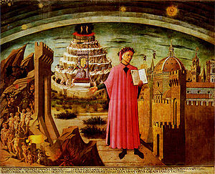
The Divine Comedy by Dante Alighieri (1265-1321)
Divine Comedy (between 1308 & 1321): Significance?
The Divine Comedy went loss it s popularity during the Enlightenment (1700s) but was "rediscovered" by William, Blake– who illustrated several passages of the epic – and the romantic writers of the 19th century. Later authors such as T.S. Elliot, Ezra Pound, Samuel Beckett, C.S. Lewis and James Joyce have drawn on it for inspiration. The poet Henry Wadsworth Longfellow was its first American translator,

Slide 15
EUROPE DIVIDED & WEAKENED DURING THE 14TH AND 15TH CENTURIES
Know the impact of the Plague on European development
Know the impact of the Ecclesiastical crisis
Boniface VIII (Unam Sanctum)
Babylonian Captivity (1309-77)
Great Schism (1378-1417)
Conciliar Movement
Impact of Northern Europe’s crises on Italian development
What do these three men have in common? Know their significance!
Marcilius of Padua (1274- 1342)
John Wycliffe (Lollards) – 1320-1384
John Hus (1369-1415)

