Slide 1
European Society in the Age of the Renaissance
1350-1550

Slide 2
Renaissance Europe: Essential Questions
1. The Impact of the 15th Century Commercial Revolution on the Development of Europe
2. Compare and contrast Italian & Northern Humanism
3. Compare and contrast the development of the 15th & 16th centuries “New Monarchies”

Slide 3
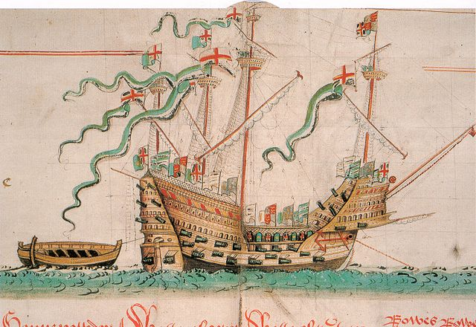
Wealth and Power in Renaissance Italy
How did the political and economic
developments in Italy shape the Renaissance?
A. Trade and Prosperity
Improvements in Shipbuilding
Rise of Florence
Prosperity
Communes and Republics of Northern Italy
Communes
Social and Political Structures
Signori
Notes:
Renaissance means rebirth used to describe the rebirth of culture of classical antiquities in Italy in 14th to 16th Century.
Venice, Genoa, and Milan grew rich through oversea trade by ship.
Florence was a commercial hub buying and selling all types of goods throughout Italy and the Mediterranean like grain, cloth, wool, weapons, armor, spices, glass and wine. Florentine merchants also lent and invested money. Eventually acquiring control of papal banking. Dominated European banking, pumping profits into industries like clothmaking. Dominated politics and culture 80,000 people by early 14th century.

Slide 4
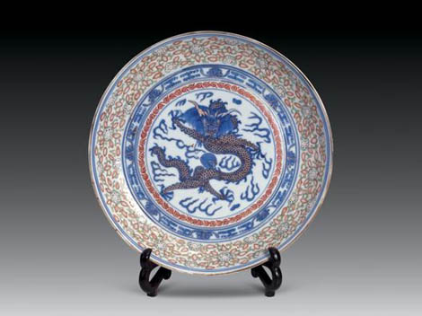
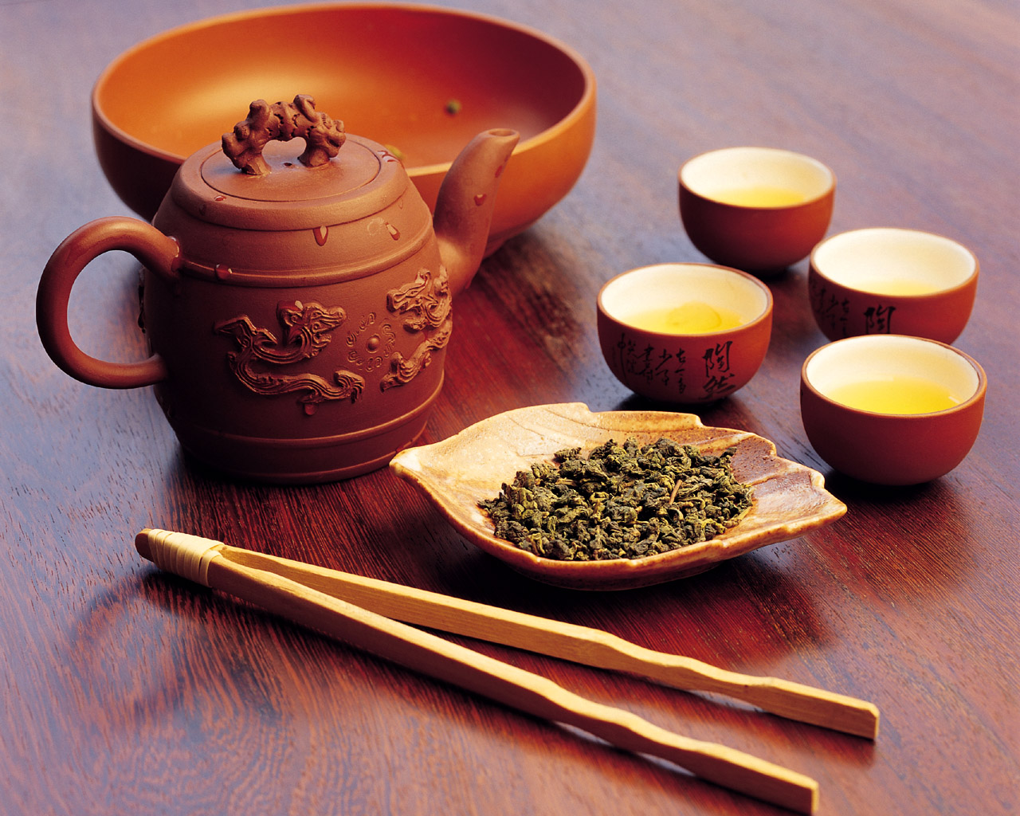
Characteristics of Trade
luxury items import/export

Slide 5
Italian Trade Routes

Slide 6
1300-1450 ECONOMIC DEPRESSION
Causes:
floods
Hundred Years War
famines (1315-17)
Italian Wars
bankruptcies
Black Death (1348-50)

Slide 7
Economic disasters hastened rather than retarded transition from medieval to modern world
1. Impoverishment of nobles and disruption of manorial system
2. Shrinking markets, smaller profits, keener competition led to major changes in business.

Slide 8
Shrinking markets, smaller profits, keener competition led to development of more efficient business techniques
new trade routes and new ships
b. sedentary merchants and resident agents
c. Commenda (silent and active partners)
d. family firms
e. double-entry bookkeeping
f. credit problem with coinage
g. bills of exchange
h. loans
i. money lenders vs. usury
j. investing money – the Bardi example
Notes:
Bardi Family, an aristocratic Florentine family that successfully developed its financial and banking company to become one of the most influential European business powers between 1250 and 1345.
By coordinating its political activity with its financial interests, the Bardi became the leading Florentine merchant house. Along with many other Florentine aristocratic families, their power was curtailed somewhat by ordinances of 1293 and 1295. Despite the loss of several estates in 1341, the family retained its prominent political position, until unwise financial ventures, including support of Edward III (king of England 1327–77) in the Hundred Years’ War against France (1337–1453) and aid to Florence in a war with the rival city of Lucca, caused the bankruptcy of the Bardi’s banking house in 1345. This bankruptcy provoked resounding financial repercussions in Florence and Europe and deprived the Bardi of their political power.

Slide 9
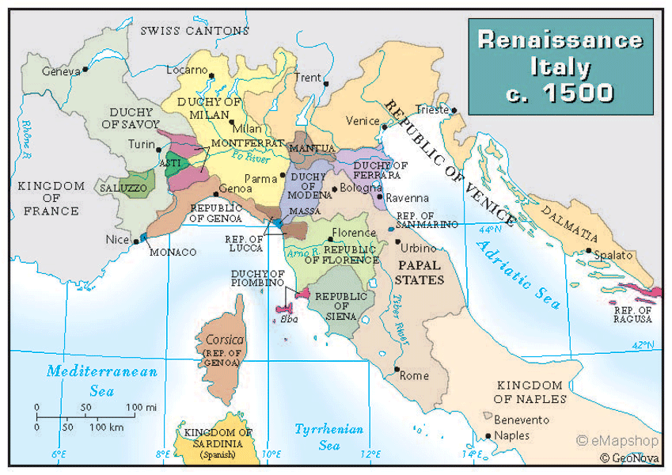
The “Big Three”: Florence , Milan, & Venice

Slide 10
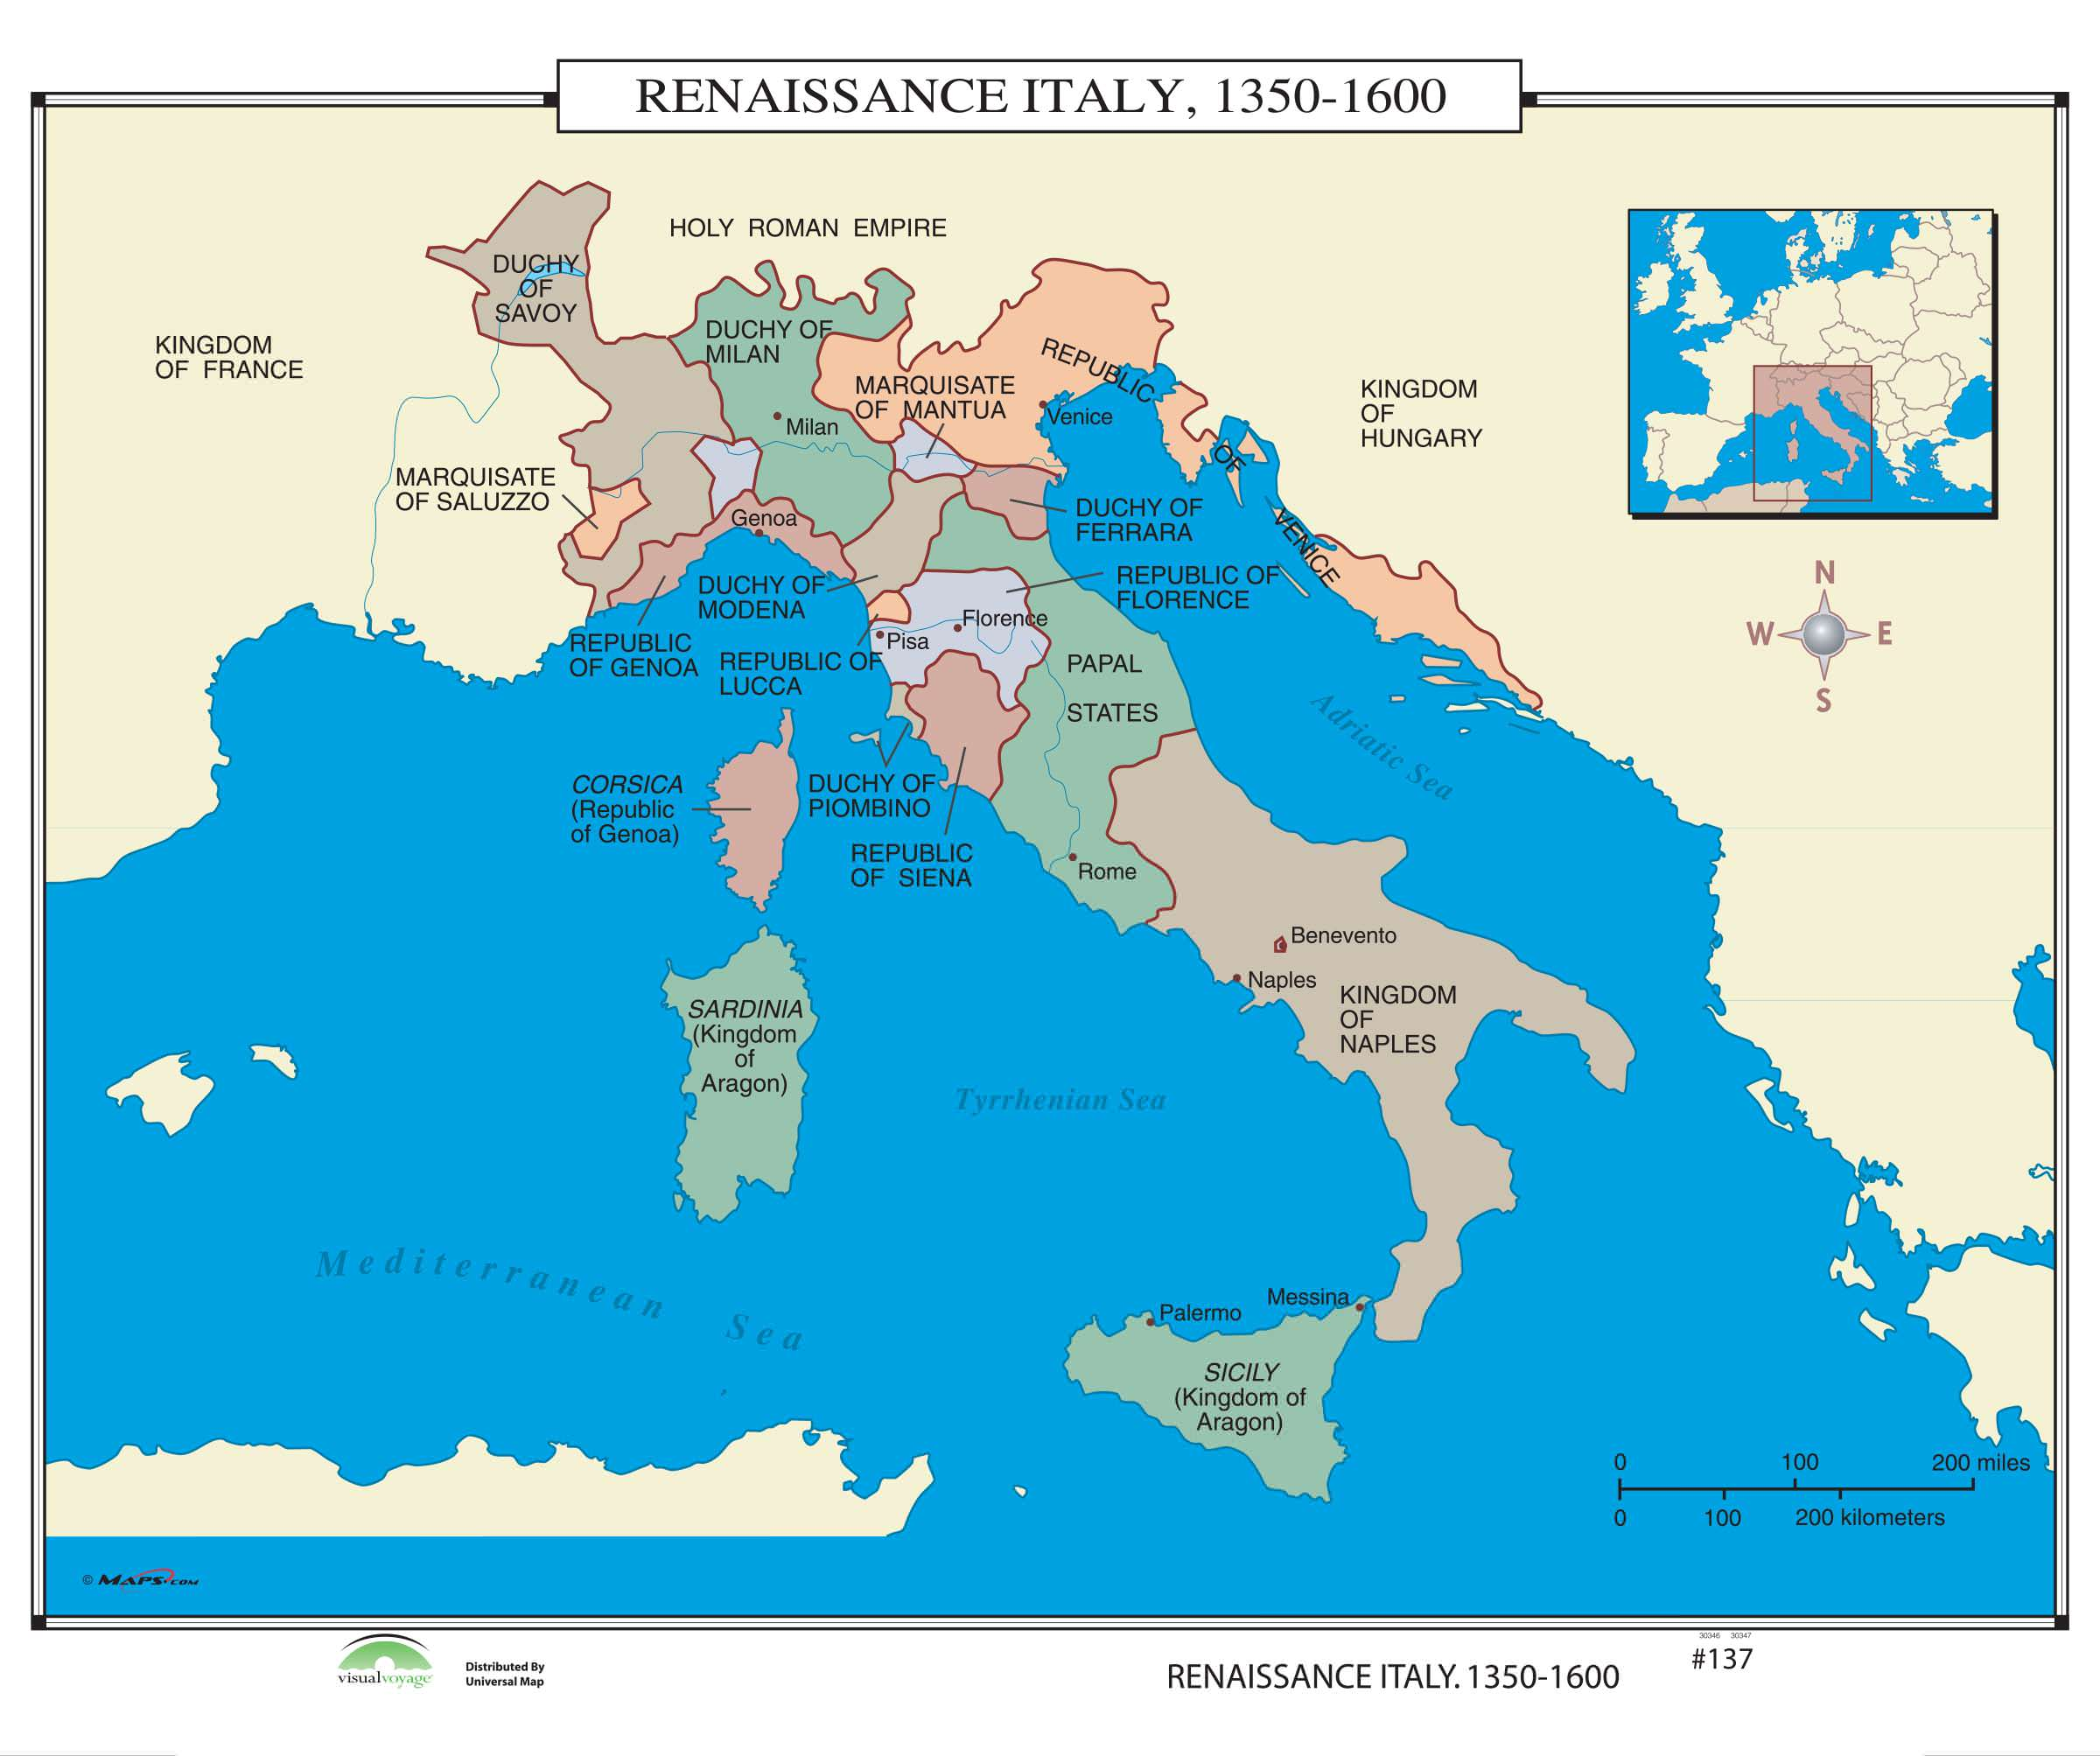
Wealth and Power in Renaissance Italy
City-States and the Balance of Power
Five Major Powers
Competition and Diplomacy
The French Invasion and Savonarola

Slide 11
Poetry: “The ability to write Latin verse is one of the essential marks of an educated person” (Battista Guarino)
Major poets of Rome and Greece held an important place in the humanity syllabus
Homer, Virgil Horace, Seneca Ovid
The humanists loved Dante despite his work in the vernacular: Christian literature was not enough

Slide 12
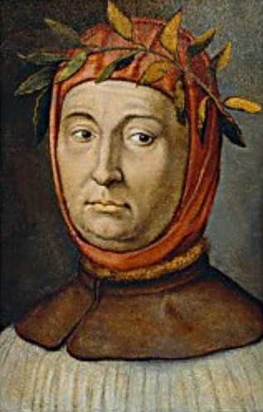
Intellectual Change
What new ideas were associated with the renaissance?
Humanism
Petrarch 1304-1374
Cicero and Plato
Virtu
Leon Battista Alberti
Education
Humanist Schools
Education for Women
Baldassare Castiglione’s The Courtier (1528)

Slide 13
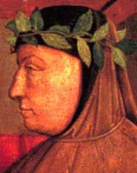
Petrarch (1304-1374) : “Father of the Renaissance”
Skeptic & critic
Antiquity provided the more effective and praiseworthy models for human behavior
Bring to light ancient texts and study the great writings of the classical world

Slide 14
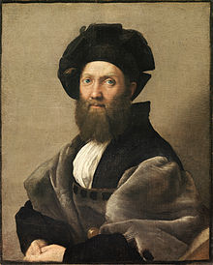
Baldassare Castiglione’s The Courtier (1508)
In the Middle Ages, the perfect gentleman had been a
chivalrous knight who distinguished himself by his prowess on the battlefield. Castiglione's book changed that. Now the perfect gentleman had to have a classical education in Greek and Latin letters, as well. The humanist model of the ideal orator (whom Cicero called "the honest man"), on which The Courtier is based, prescribes for the orator an active political life of service to country, whether in war or peace.

Slide 15
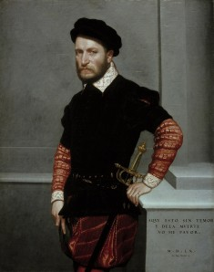
Baldassare Castiglione’s The Courtier (1528)
The Book of the Courtier caught the "spirit of the times" and was speedily translated into Spanish, German, French, Polish, and English. One hundred and eight editions were published between 1528 and 1616 alone. Castiglione's depiction of how the ideal gentleman should be educated and behave remained, for better or for worse, the touchstone of behavior for all the upper classes of Europe for the next five centuries.

Slide 16
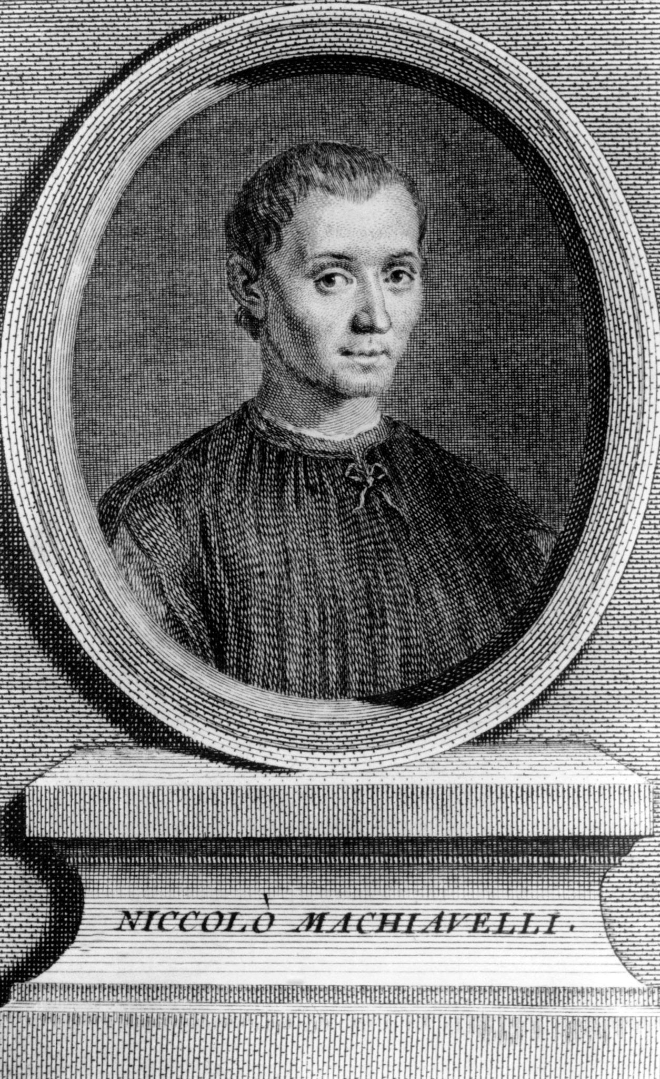
Intellectual Change
Political Thought
Civic humanism
Niccolò Machiavelli (1469-15270
Differences with Medieval Political Philosophy
Christian Humanism
Beliefs
Thomas More (1478-15350
Desiderius Erasmus

Slide 17
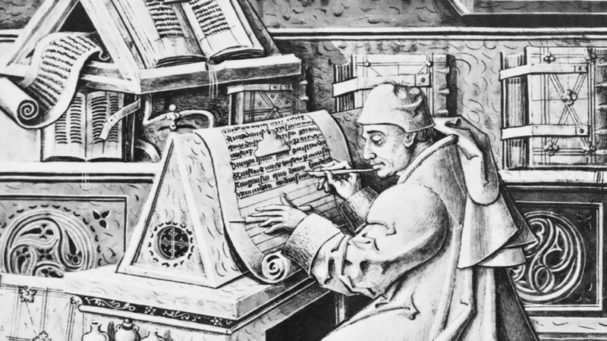
Intellectual Change
The Printed Word
Printing press
Expanded Market for Reading
Impact

Slide 18
Art and the Artist
Patronage and Power
Patrons
Artists
Reasons for Patronage
Changing Artistic Styles
Themes
Training
Women Artists
Limits of Renaissance Culture

Slide 19
Five key Motives for Buying or Commissioning Art During the Renaissance:
Serve and honor God
Honor your city state (example of …)
Commemoration of the client
Growing sense to own something beautiful & enjoyment in looking at fine art
Outlet for the pleasure & virtue of spending money well

Slide 20
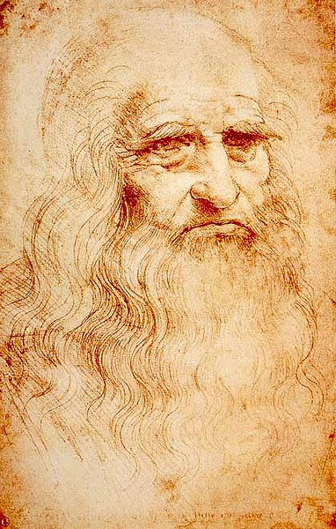
Arts and the Artist
The Renaissance Artist
Concept of Genius
Training
Women Artists
Limits of Renaissance Culture

Slide 21
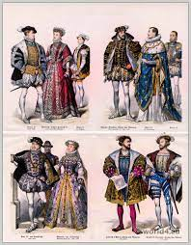
Social Hierarchies
Race and Slavery
Race
Slavery
Black Slaves
Wealth and nobility
Hierarchy of Wealth
Hierarchy of Orders
Honor

Slide 22
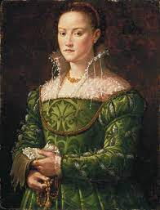
Social Hierarchies
Gender Roles
Debate about Women
Popular interest in the debate
Debates about female rulers
Women’s status

Slide 23
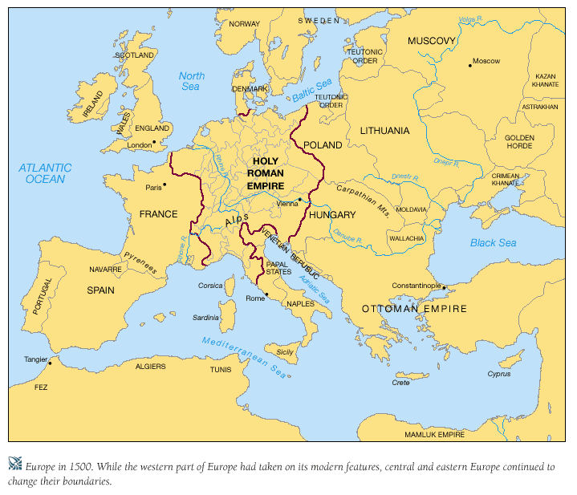
Politics and State in Western Europe
France
Political Stabilization
Key Marriages
Religious Stability
England
Disorder
Stabilization
Methods

Slide 24
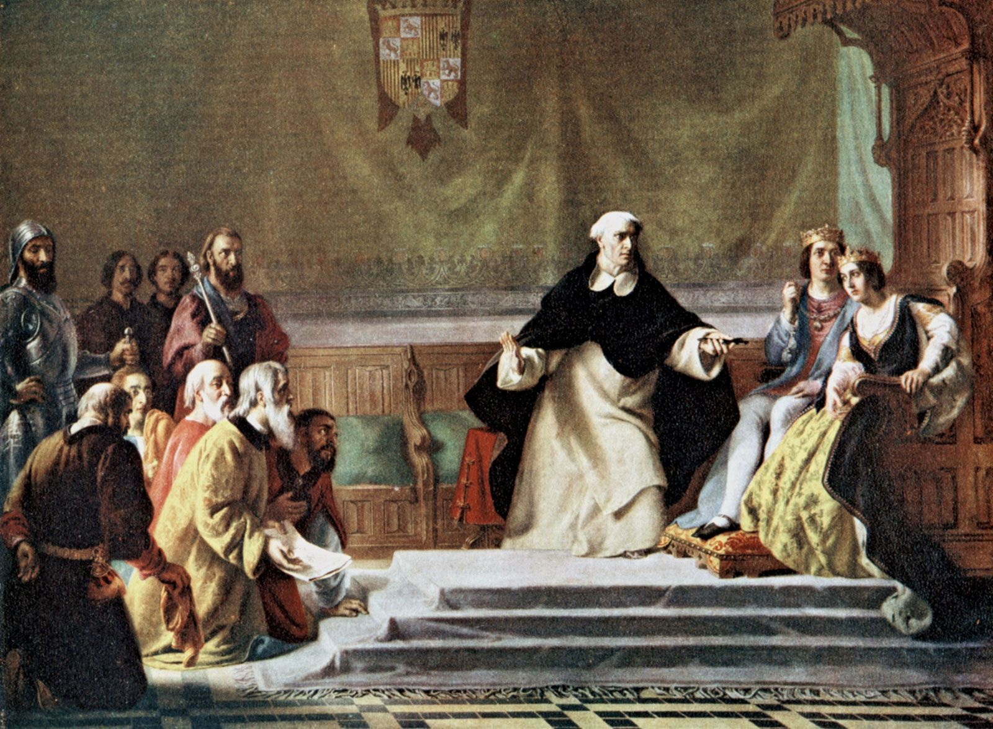
Politics and State in Western Europe
Spain
Confederation
Spanish Monarchy
Anti-Jewish Attitudes
The Inquisition
Expulsion (1492)

